Slide 1
Promises

Slide 2
Contents
Promises
Fetch api
Async/Await

Slide 3
Promises : es5
let promise = new Promise(function(resolve,reject){
let x=true;
if(x)
resolve("yes");
else
reject("no");
})
promise.then(function onSucceed(result){
console.log(result);
}).catch(function onFailed(result){
console.log(result);
})
//yes

Slide 4
Promises : arrow function
let promise = new Promise((resolve, reject) => {
let x=true;
if(x)
resolve("yes");
else
reject("no");
})
promise.then(res => {
console.log(res);
}).catch(err => {
console.log(err);
});
//yes

Slide 5
~practice~ Promises
let promise = new Promise((resolve, reject) => {
let x =2000;
function callback(){
if(x) resolve("yes");
else reject("no");
}
setTimeout(callback,x);
console.log(`delay ${x}...`);
})
promise.then(res => {
console.log(res);
}).catch(err => {
console.log(err);
}). finally(()=> {
console.log("finished")
});
//delay 2000...
[note : will print after 2 seconds]
//yes
//finished

Slide 6
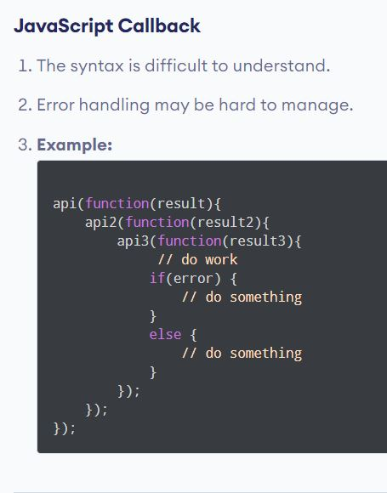
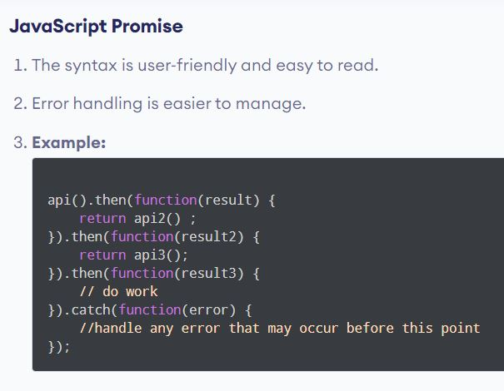
Promises Vs Call backs
Promise Chaining
Pyramid of Doom

Slide 7
Promisification
It’s the conversion of a function that accepts a callback into a function that returns a promise.
let loadScriptPromise = function(callback) {
return new Promise((resolve, reject) => {
if (callback()) resolve("succeed");
else reject("rejected");
});
};
loadScriptPromise(()=>true).then(res=> {console.log(res)})
.catch(err => {console.log(err)});
//succeed

Slide 8
Fetch api
Fetch api returns promises.
let promise = fetch('https://jsonplaceholder.typicode.com/todos/1’);
promise
.then(response => response.json())
.then(json => console.log(json))
.catch(err => { console.log(err);})
.finally(()=> { console.log("finished") });

Slide 9
Async/Await
There’s a special syntax to work with promises in a more comfortable fashion, called “async/await”. It’s surprisingly easy to understand and use.
Async functions always return a promise. If the return value of an async function is not explicitly a promise, it will be implicitly wrapped in a promise
async function f() {
let promise = new Promise((resolve, reject) => {
setTimeout(() => resolve("done!"), 1000)
});
let result = await promise; // wait until the promise resolves (*)
alert(result); // "done!"
}
f();

Slide 10
Async/Await : Promises chaining
async function getTodo(){
let response = await fetch('https://jsonplaceholder.typicode.com/todos/1');
let jsonData = await response.json();
return jsonData;
}
getTodo().then(res => {console.log(res)})
.catch(err => {console.log(err)});

